Slide 1
How to help library patrons find good legal information
Michelle Cader
February 1, 2017
Notes:
Hello. I’m Michelle Cader, Community Outreach Manager iat CLEO.

Slide 2
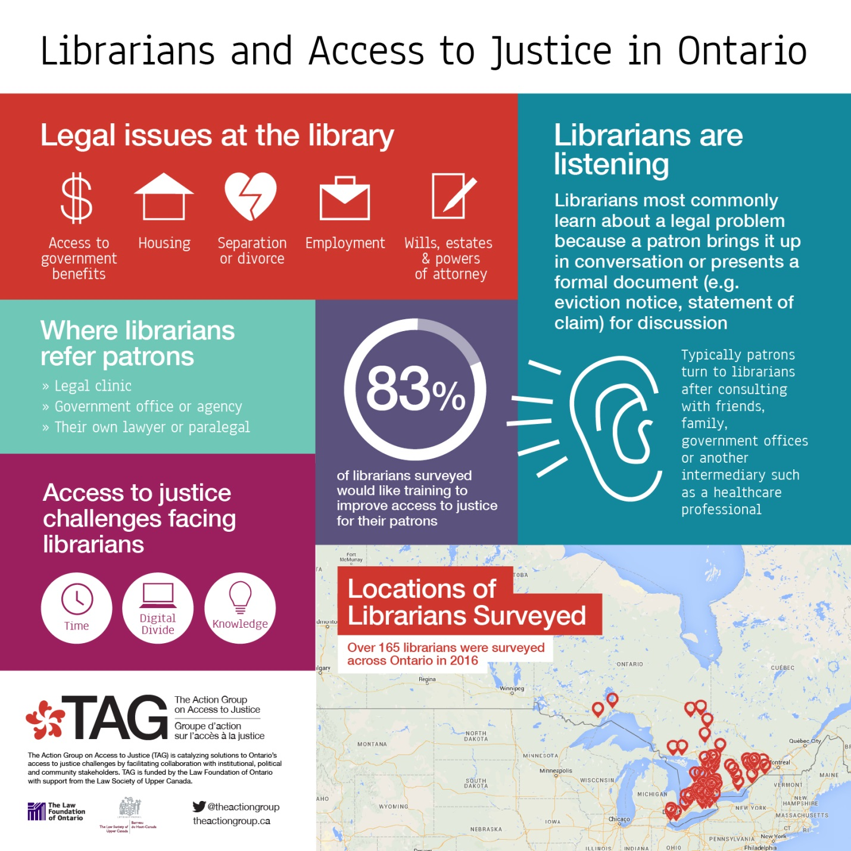

Slide 3
Outline
Who is CLEO?
Why legal information is key and what library staff’s role can be
Tools to help people find legal information
Legal information vs. legal advice
CLEO’s legal information
Making good referrals for legal advice and representation
Evaluation

Slide 4
Who is CLEO?
expertise in producing legal information
plain language and clear design
all resources free
in print, online, in multiple languages
over 70 legal resources
9 subject areas – “poverty law” areas
legally accurate, up-to-date
focus on needs of low-income and marginalized communities
receive government funding
4
Notes:
Been around for over 40 years
Hallmarks: of our work -- specialty clear language and design – focus on people with barriers of literacy, other – can be understood and put to use after reading first time
-- up to date and legally accurate
-- practical – reflects real-world – what people are likely to encounter (not just how we wish it were)
Legal clinic == about 55% of our funding from LAO; other funding from DOJ Canada, LFO, Ontario Gov’t
Staff includes four lawyers, three clear language editors, outreach manager, four special project managers
Non-profit charity – governed by 12-member Board of Directors
4

Slide 5
Areas of Poverty Law
abuse & family violence
consumer
criminal
employment
family
housing (tenants’ rights)
health & disability
immigration & refugee
social assistance

Slide 6
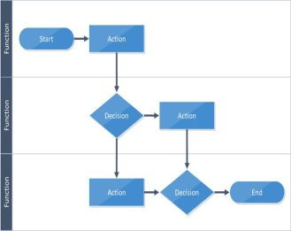
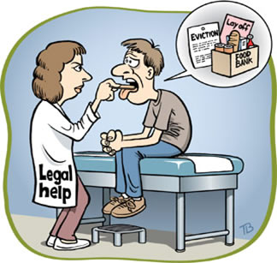
Why is legal information
important?
explains legal processes
helps maintain legal health (which impacts physical and mental health)
helps prevent legal conflict

Slide 7
Legal information can help with many legal issues
conflict stage
-need legal advice/rep
lawyer or paralegal
15%
5% - complex
client advocacy
85%
preventative stage
-legal info helps maintain legal
health
10% - legal representation
- formal claim
frontline workers (e.g. library staff)
35% - 3rd party non-lawyer assistance
e.g. librarians, service providers
Adapted from Courthouse Libraries BC - LawMatters Presentation, Janet Freeman
Originally from Washington State Equal Justice Network

Slide 8
Why do library staff have a key role?

Slide 9
Tools to help people find legal information

Slide 10
4 Tools
1. Legal topics and sub-topics
2. Method to detect legal issues
3. Sources of legal information
4. Checklist for reliability of information

Slide 11
Tool 1: Legal topics and sub-topics
Legal topic
Sub-topics

Slide 12
Immigration & Refugee law
Temporary status
Citizenship
Detention
Sponsorship
Humanitarian and compassionate grounds
Refugees
People without status
Permanent resident status

Slide 13
CLEO’s Your Legal Rights website
Legal topic
Sub-topics

Slide 14
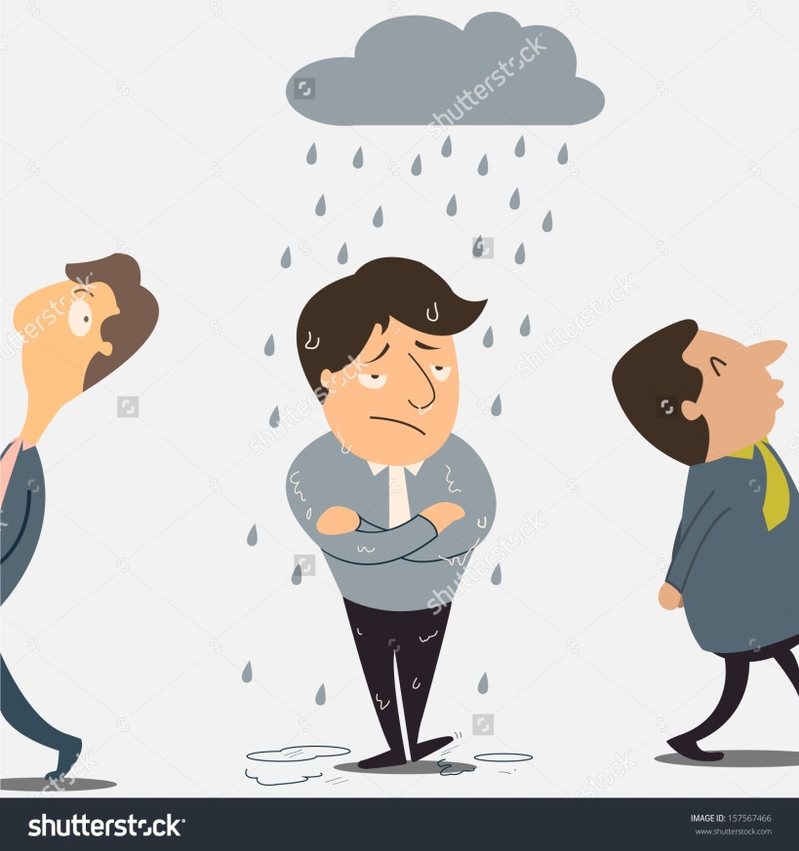
People are not identifying issues as ‘legal’
50% - think legal problem is just ‘bad luck’

Slide 15
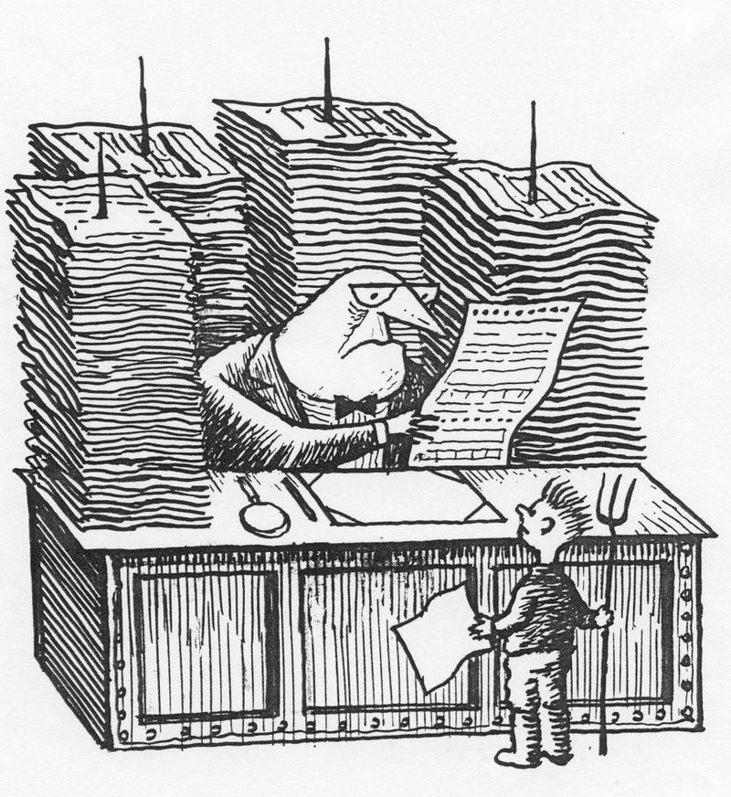
30% - think legal problem is just “social’ or ‘bureaucratic’

Slide 16
11% - identify problem as ‘legal’
*If problem isn’t identified as ‘legal,’ people don’t seek legal information or legal help

Slide 17
Tool 2: Method to detect legal issues
Process:
Person presents issue
You identify:
main (obvious) legal topic → then funnel it down
sub-topic(s)
3. You ask questions to detect related legal issues

Slide 18
Method to detect legal issues
Example:
Presenting issue = I’m living in a terrible apartment. The stove is broken, the lock on the door is loose and the rent keeps going up. I want to move out but I can’t break my lease. And I have bad credit so I won’t be able to rent another apartment. What can I do?
You identify:
main (obvious) legal topic = housing
sub-topic(s) = laws that protect tenants
= moving out

Slide 19
3. Ask questions to identify related legal issues
Have you told the landlord about the stove and the lock?
legal topic = housing law
sub-topic = repairs, maintenance
How often is your rent going up and by how much?
legal topic = housing law
sub-topic = paying rent
Are there children living in the apartment with you?
legal topic = family law
sub-topic = child protection
How do you know your credit is “bad”? Have you taken any steps to try to improve it?
legal topic = consumer law
sub-topic = credit records

Slide 20
Detecting Legal Issues - Small Group Exercise #1
Look at your group’s “presenting issue”
Discuss:
a. the legal topic involved
b. the sub-topic(s) involved
c. questions you would ask to detect related legal issues
d. legal topics and sub-topics for related legal issues
3. Choose a spokesperson to share your ideas.
* Note: This exercise is not about answering the legal question.

Slide 21
Presenting Issues:
I was late paying my rent a few times and then last month I just couldn’t pay it at all. I’m supposed to be getting child support from my ex which helps with the rent but he never pays on time. Now my landlord is saying he’s going to evict me. It’s March and it’s freezing. Can I get evicted in the winter?
My sister has an intellectual disability. She has been working at the same grocery store for 5 years but they make her work on all of the statutory holidays and I think she gets paid less than the other employees. I’m the one who helps pay her bills but she doesn’t have enough money each month so I have to help her out. But I’m struggling financially too. This doesn’t seem fair.
I have been on ODSP ever since my accident a few year’s ago. Recently they did a medical review and cut me off. But I still can’t work. How can I make ends meet and care for my children without this money?
Since my wife died, I’ve had to move into my son’s apartment. But he’s not giving me enough money for groceries and medicine. And I think he’s taking my Old Age Security cheques. He’s hardly ever home and sometimes stays out all night. I want to live somewhere else but I don’t have anywhere to go.
My mother had a stroke a few months ago and she is still recovering. She lives on her own and she just signed a contract with a door-to-door salesperson for a new energy contract. The person convinced her that she would be saving money but it looks like a she’ll actually be paying more. Can she get out of it?

Slide 22
Tool 3:
Sources of Legal Information

Slide 23
Sources of Legal Information
Legal topic | Source
Variety of topics | CLEO
 | CLEO’s Steps to Justice
 | CLEO’s Your Legal Rights
Employment | Ontario Ministry of Labour
 | Workers’ Action Centre
Family | Family Law Education for Women (FLEW)
 | Family Law Information Program
 | Ministry of the Attorney General (MAG)

Slide 24
Sources of Legal Information
Legal topic | Source
Housing | Advocacy Centre for Tenants Ontario (ACTO)
 | Centre for Equality in Accommodation
 | Federation of Metro Tenants’ Associations (FMTA)
Human Rights | Human Rights Legal Support Centre (HRLSC)
Immigration | Refugee Rights in Ontario (CLEO)
 | Settlement.org
Youth and the law | Justice for Children and Youth
 | Youth Criminal Law (CLEO)

Slide 25
Tool 4: Checklist for reliability of information
Does it apply in my area?
Is it up to date?
Is it from a trustworthy source?
Does website follow best practices?

Slide 26
Legal Information vs. Legal Advice:
Knowing the Difference

Slide 27
Legal Information
Legal Advice

Slide 28
Legal Information
Legal Advice
general information
identifies legal problems
explains process
gives options & next steps
tells when advice needed
tells where to find advice
specific to situation
interprets law
applies legal rules
gives recommendations
shares expected outcome
helps fill out legal forms
Notes:
Legal Info - general information not tailored to an individual’s specific situation,
helps a person understand when a problem is a legal problem
discusses options and possible next steps
indicates when a person needs to get more help and advice, and how to find that help
Legal advice:
applies legal rules and principles to a particular situation
must be particular b/c people’s situations and circumstances are different even when facing the “same” legal problem
considers the options and provides recommendations to a person
considers what that person wants to achieve

Slide 29
What can library staff do?
You can:
You cannot:
help identify legal issues
help people find legal info
tell people where to get legal advice
If you have 1:1 time with someone:
help fill out non-legal forms
make notes for people to take to legal appointment
tell people what to expect from lawyer
tell people they have good or bad case and how much $ they might get
tell people they need to go to court or do mediation
help people fill out legal documents or legal forms
explain a lawyer’s letter

Slide 30
Question: I received an eviction notice from my landlord because I haven’t been paying my rent on time. Will I definitely have to leave?
Do’s and Don’ts
Don’t
Do
Tell person legal outcome to expect
“No. You can fight the eviction by going to the Landlord and Tenant Board and they will give you another chance.”
Provide Legal Information
“I can show you some information that explains the eviction process. It also tells you about the options of what you can do if you get an eviction notice. From there you can decide what you would like to do and get legal help if you’d like.”

Slide 31
Legal Information vs. Advice – Exercise #3
Find a partner
Choose who will be the client and who will be the service provider.
Look at the sample questions on the next slide. Choose a question and roleplay the question so that the service provider is providing the client with legal information as opposed to legal advice.
4. Discuss your experience and questions with the
large group.

Slide 32
Sample Questions for Partner Exercise:
How much child support will I receive from my ex?
My landlord comes into my place whenever she wants. I’m just going to get the locks changed so she can’t come in. I can do that, right?
I’ve been charged with assault. If I’m convicted, what will my sentence be?

Slide 33
CLEO’s Legal Information:
3 main websites

Slide 34
Comparison of CLEO websites:
Website | Description
CLEO cleo.on.ca | -online & print plain language legal resources for people in ON -written and kept up-to-date by CLEO lawyers -9 legal topics and some info in other languages

Slide 35
Comparison of CLEO websites:
Website | Description
CLEO cleo.on.ca | -online & print plain language legal resources for people in ON -written and kept up-to-date by CLEO lawyers -9 legal topics and some info in other languages
Your Legal Rights yourlegalrights.on.ca | -online library of legal resources for people in ON -written by 100’s of different organizations -resources in 39 languages -news & events section -archive of all training webinars

Slide 36
Comparison of CLEO websites:
Website | Description
CLEO cleo.on.ca | -online & print plain language legal resources for people in ON -written and kept up-to-date by CLEO lawyers -9 legal topics and some info in other languages
Your Legal Rights yourlegalrights.on.ca | -online library of legal resources for people in ON -written by 100’s of different organizations -resources in 39 languages -news & events section -archive of all training webinars
Steps to Justice stepstojustice.ca | -online plain language legal information for people in ON -written and kept up-to-date by CLEO lawyers -‘next steps’ approach -checklists, forms and self-help guides -referral info for legal and social services -live chat and email-based support -content can be embedded on your website

Slide 37
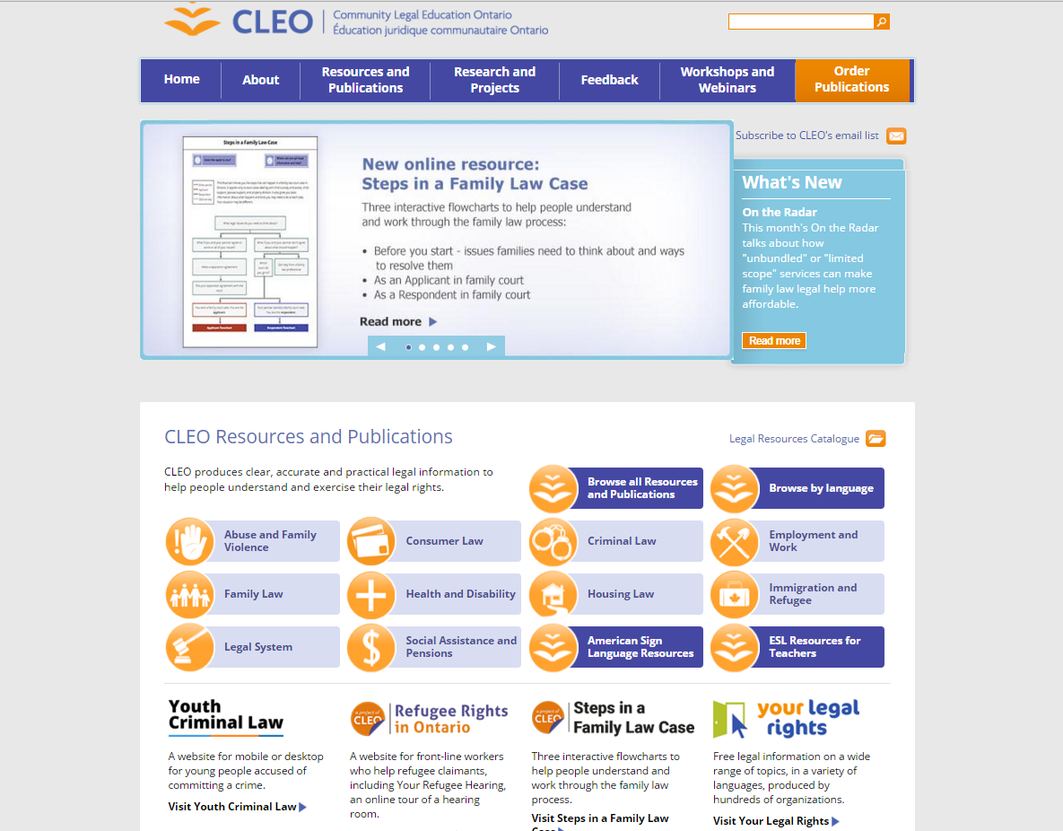
CLEO homepage

Slide 38
Legal topics

Slide 39
Legal Resources Catalogue

Slide 40
Online ordering (free)

Slide 43
Homepage

Slide 45
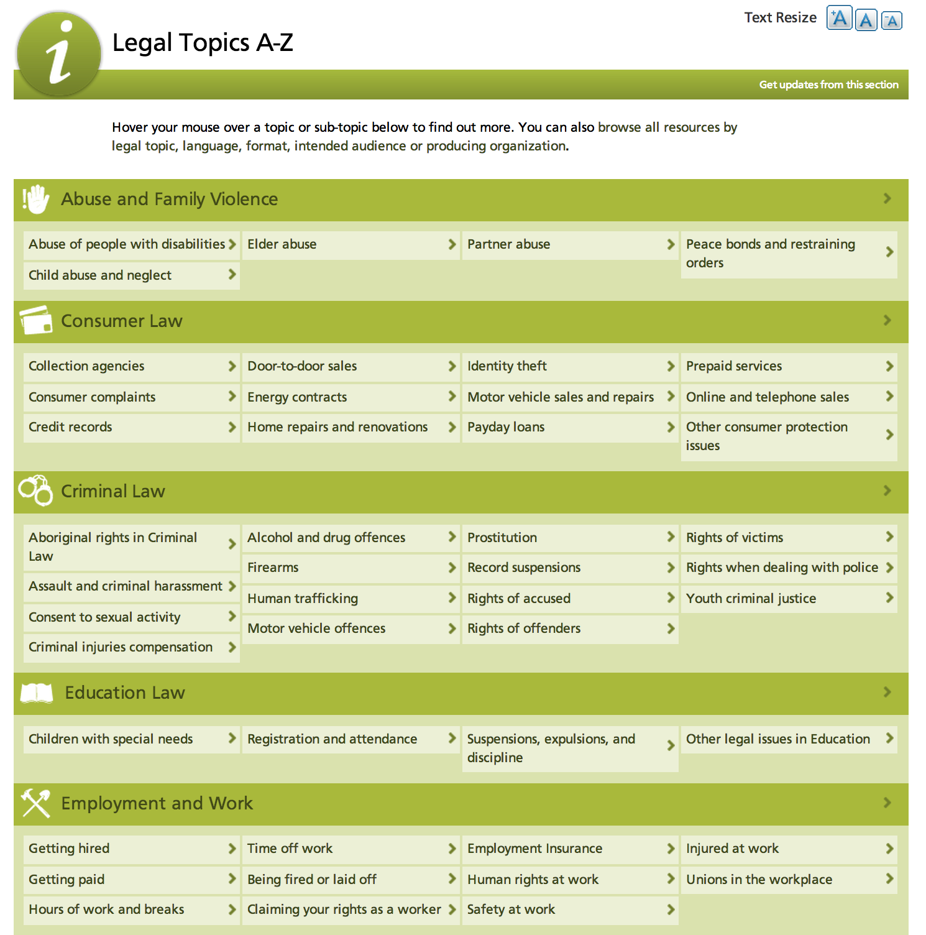
Tool 1: Legal topics and sub-topics

Slide 47
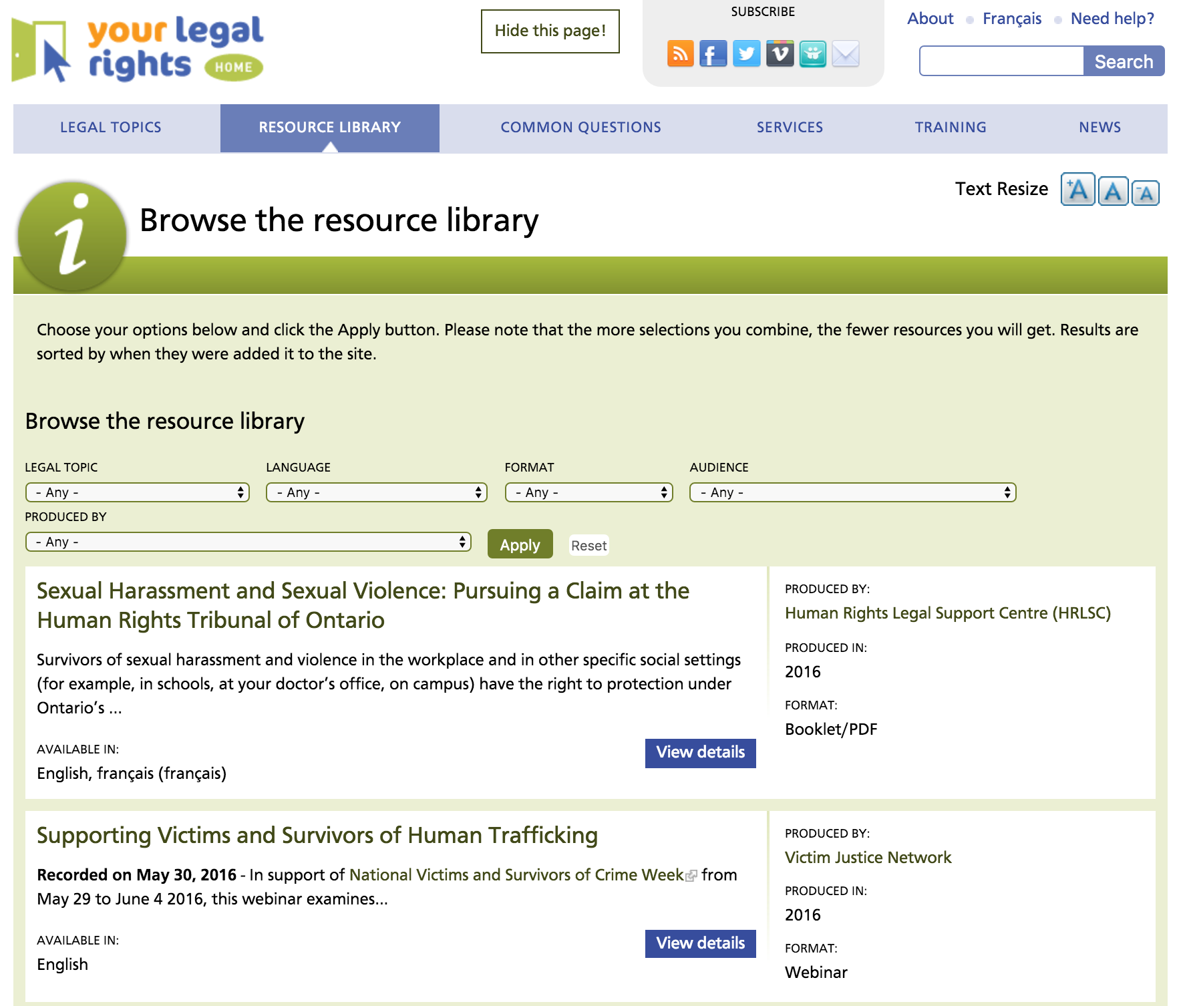

Slide 52
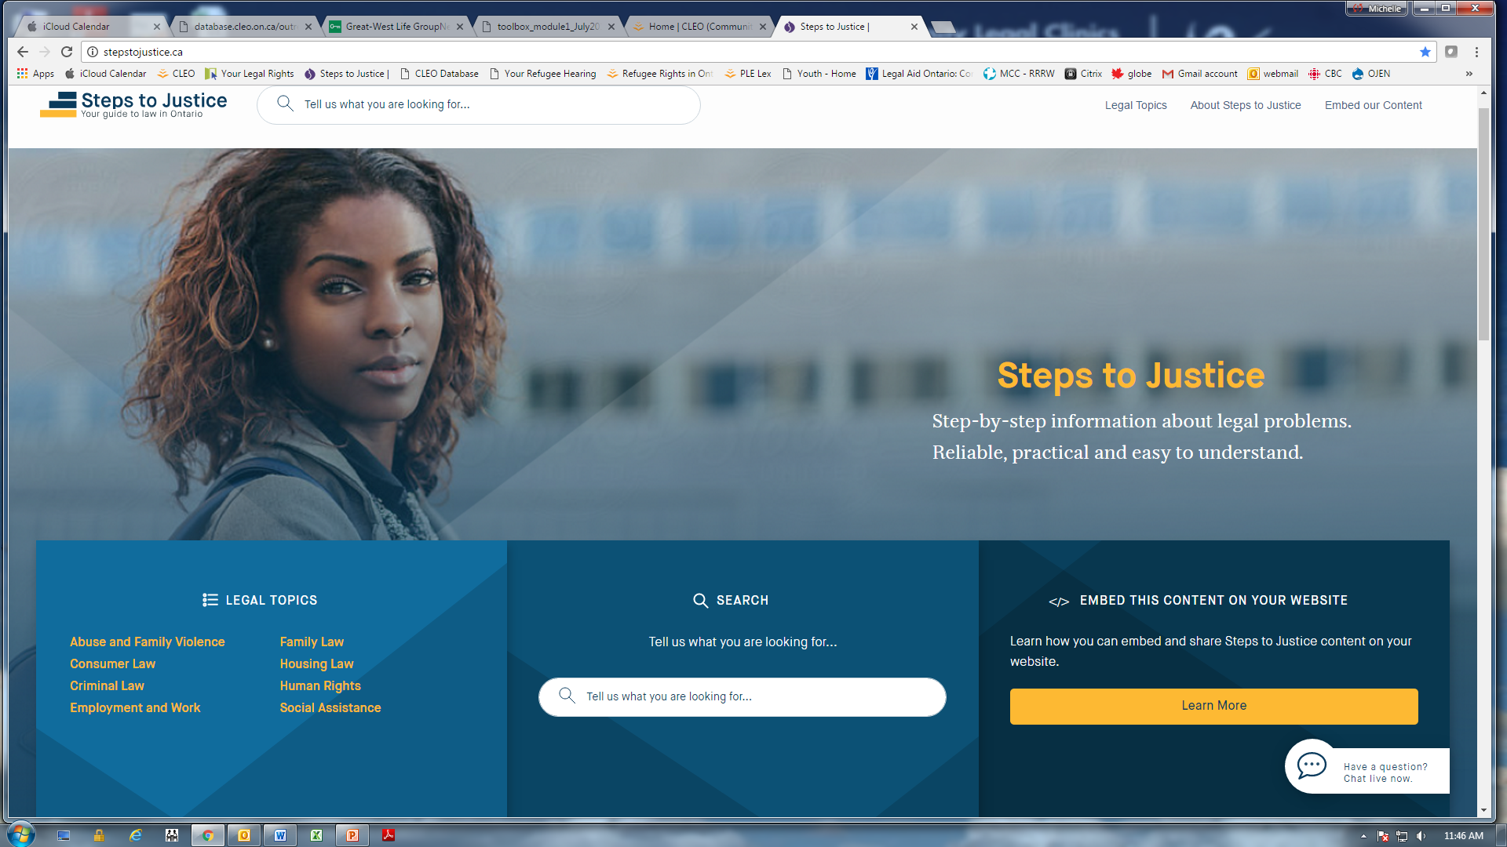
Homepage

Slide 55
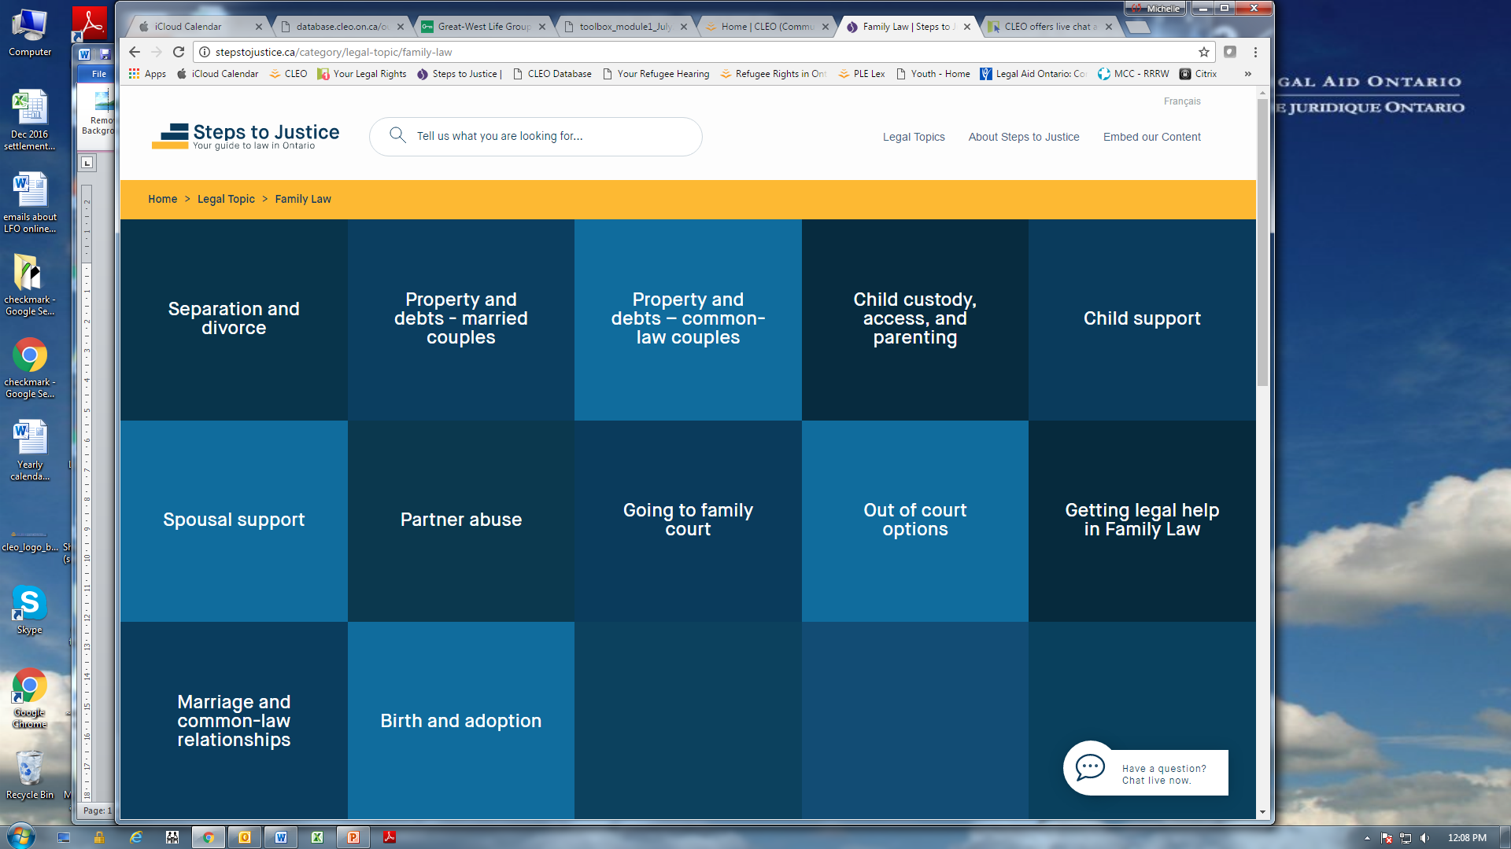
Sub-topics

Slide 57
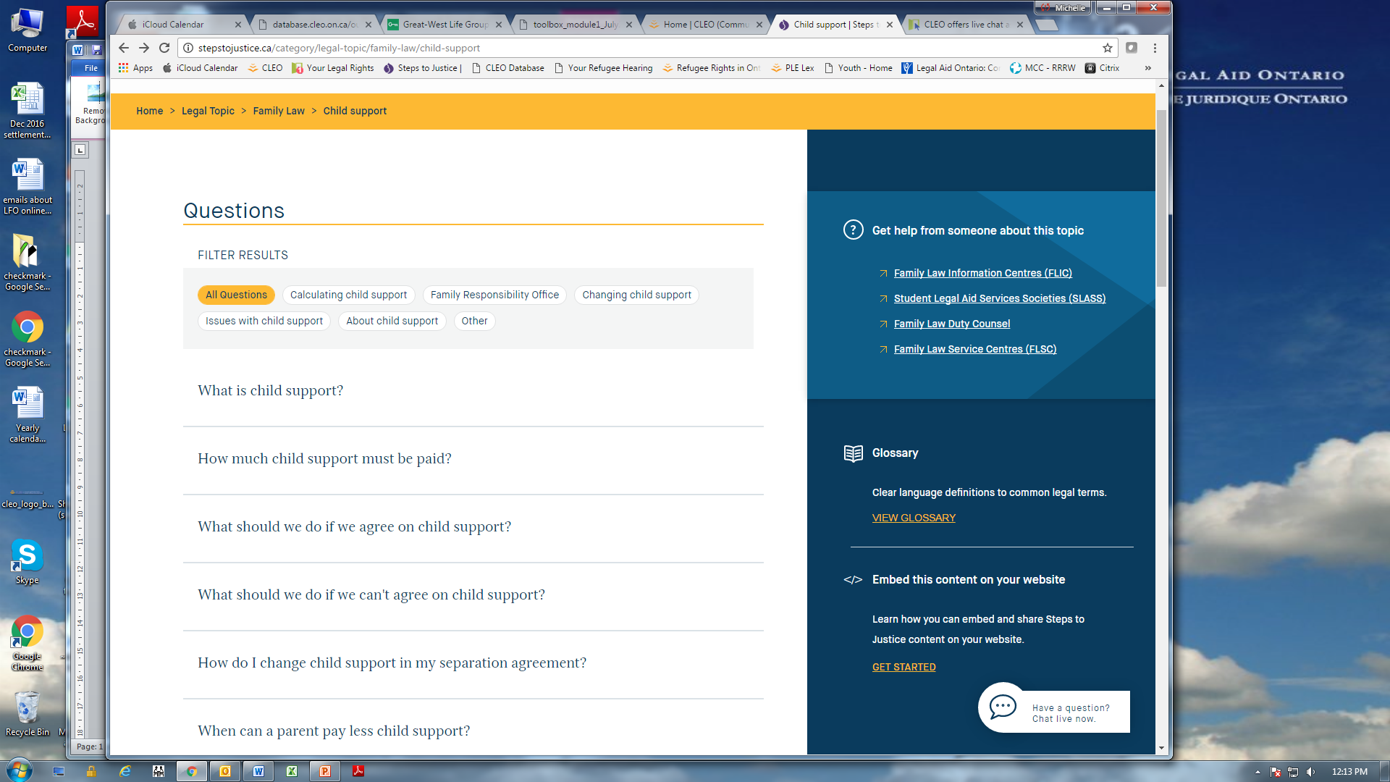
Related questions

Slide 59
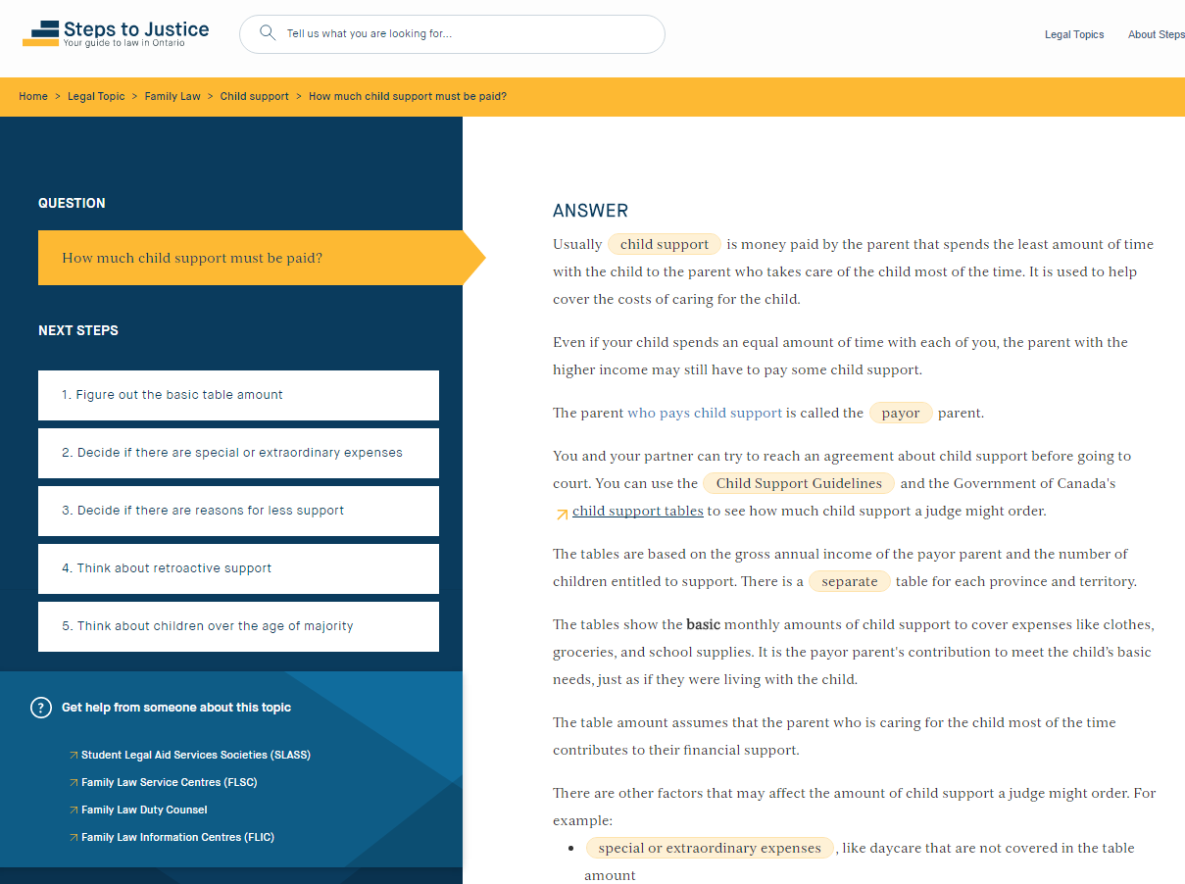

Slide 62
referrals

Slide 63
keyword/term search

Slide 64
embed

Slide 65
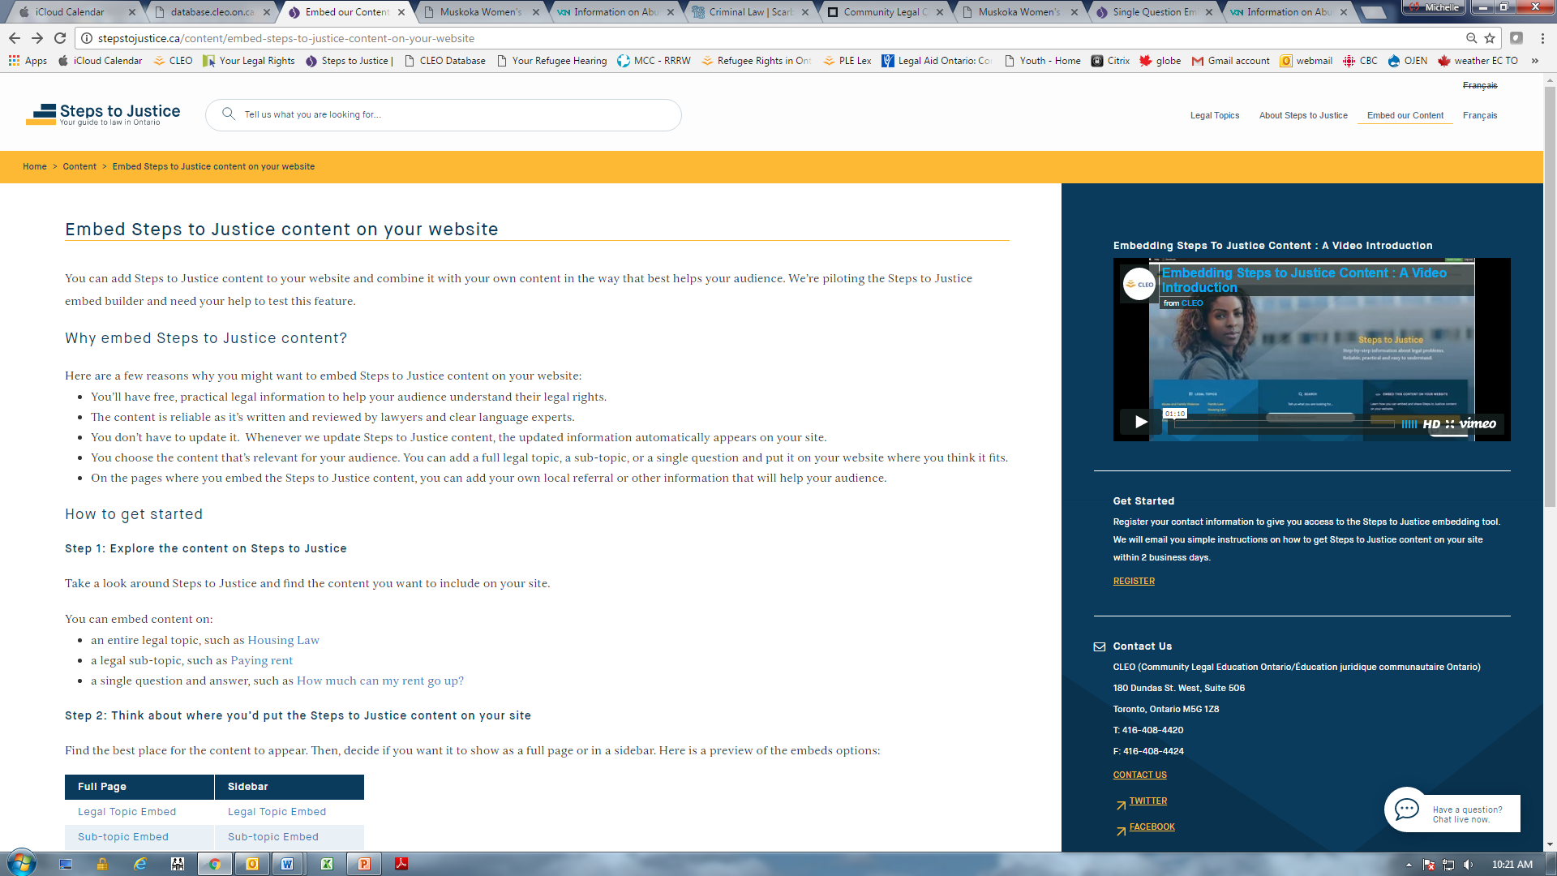

Slide 66
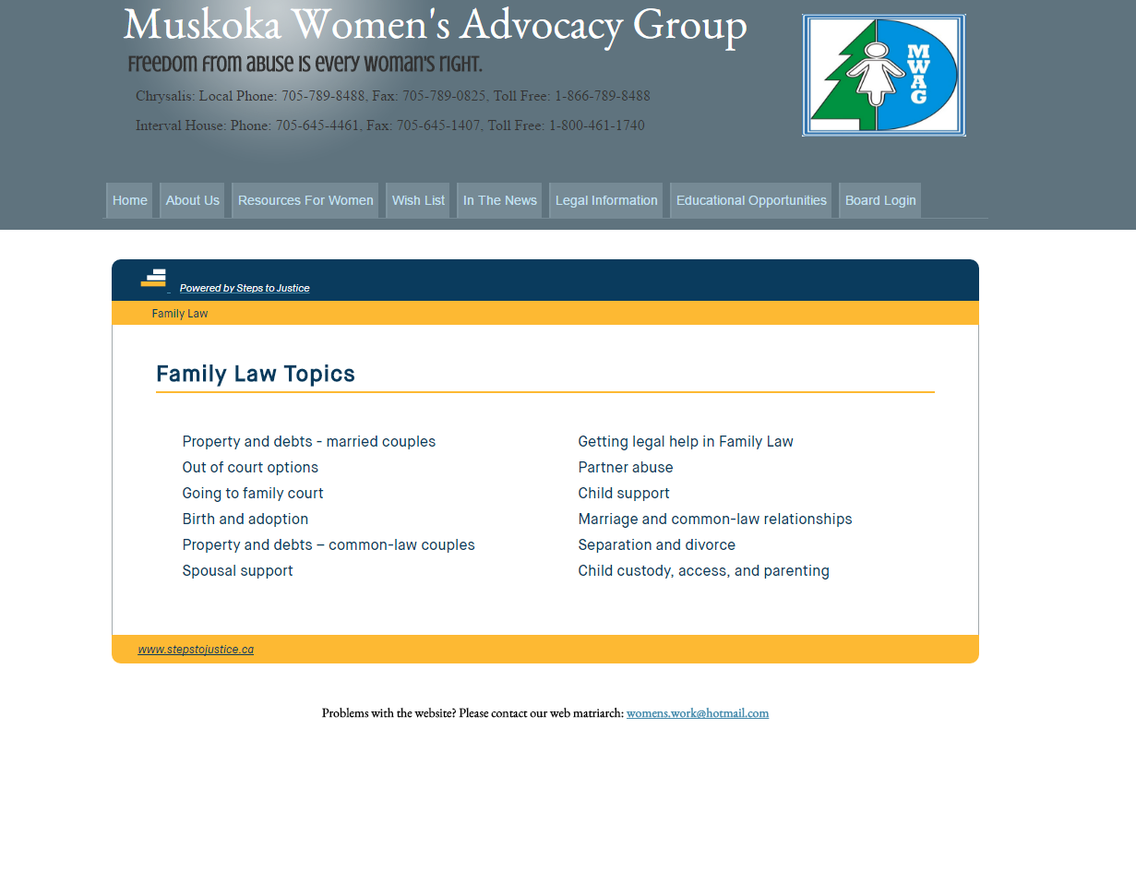
Example of how embed looks

Slide 67
Making good referrals for legal advice/representation

Slide 68
Legal advice/representation – See Handout
Source

Slide 69
Legal advice/representation – See Handout
Source
Community Legal Clinics (general)

Slide 70
www.kbcls.org/
Areas of law:
Housing
Employment Insurance
Employment standards
Immigration & refugee
OW, ODSP, CPP, OAS
Human rights
Domestic violence
CICB

Slide 71
Legal advice/representation – See Handout
Source
Community Legal Clinics (general)
Community Legal Clinics (specialty) – e.g. Advocacy Centre for the Elderly

Slide 72
Legal advice/representation – See Handout
Source
Community Legal Clinics (general)
Community Legal Clinics (specialty) – e.g. Advocacy Centre for the Elderly
Family Law Information Centres

Slide 73
Legal advice/representation – See Handout
Source
Community Legal Clinics (general)
Community Legal Clinics (specialty) – e.g. Advocacy Centre for the Elderly
Family Law Information Centres
Human Rights Legal Support Centre

Slide 74
Legal advice/representation – See Handout
Source
Community Legal Clinics (general)
Community Legal Clinics (specialty) – e.g. Advocacy Centre for the Elderly
Family Law Information Centres
Human Rights Legal Support Centre
Law Help Ontario

Slide 75
Legal advice/representation – See Handout
Source
Community Legal Clinics (general)
Community Legal Clinics (specialty) – e.g. Advocacy Centre for the Elderly
Family Law Information Centres
Human Rights Legal Support Centre
Law Help Ontario
Legal Aid Ontario – online directory, certificates, limited free legal advice (family and child protection), duty counsel, customer service, family law centres

Slide 76
Legal advice/representation – See Handout
Source
JusticeNet

Slide 77
Legal advice/representation – See Handout
Source
JusticeNet
Law Society of Upper Canada – list of lawyers and paralegals, Lawyer Referral Service

Slide 78
Legal advice/representation – See Handout
Source
JusticeNet
Law Society of Upper Canada – list of lawyers and paralegals, Lawyer Referral Service
Student Legal Aid Services Society –(Downtown Legal Services – U of T)

Slide 79
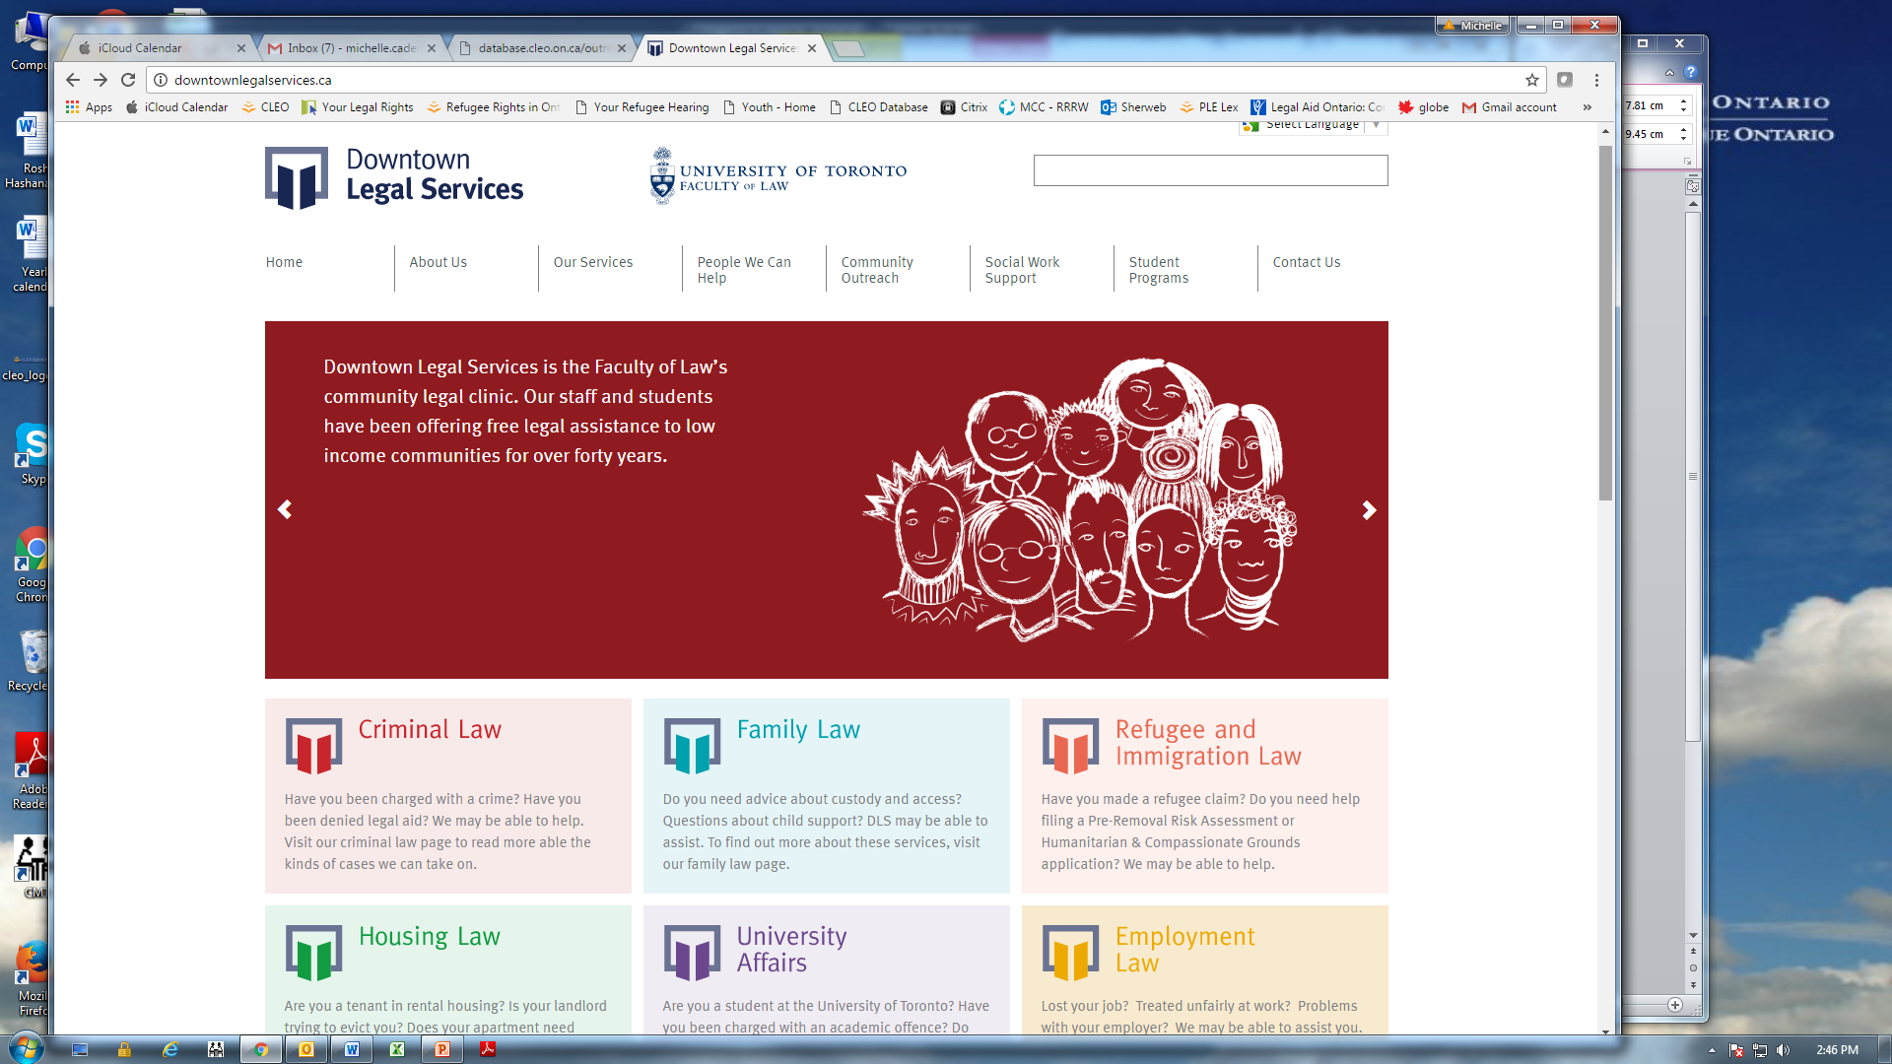
http://downtownlegalservices.ca/

Slide 80
Finding Helpful Legal Information - Small Group Exercise #2
Form same groups of 4-5
Identify an issue that people have asked you about or use one of the presenting issues from Exercise #1.
Using reliable legal information websites,
a. find helpful legal information to help this person
b. find a good referral for them if they need legal advice/ representation
4. Use handout to write the legal information you found. Include:
website(s) you used (e.g. Your Legal Rights)
title of the resource or the Question you found
one piece of useful legal information you found
where you would refer the person for legal advice/representation

Slide 81
Presenting Issues:
I was late paying my rent a few times and then last month I just couldn’t pay it at all. I’m supposed to be getting child support from my ex which helps with the rent but he never pays on time. Now my landlord is saying he’s going to evict me. It’s March and it’s freezing. Can I get evicted in the winter?
My sister has an intellectual disability. She has been working at the same grocery store for 5 years but they make her work on all of the statutory holidays and I think she gets paid less than the other employees. I’m the one who helps pay her bills but she doesn’t have enough money each month so I have to help her out. But I’m struggling financially too. This doesn’t seem fair.
I have been on ODSP ever since my accident a few year’s ago. Recently they did a medical review and cut me off. But I still can’t work. How can I make ends meet and care for my children without this money?
Since my wife died, I’ve had to move into my son’s apartment. But he’s not giving me enough money for groceries and medicine. And I think he’s taking my Old Age Security cheques. He’s hardly ever home and sometimes stays out all night. I want to live somewhere else but I don’t have anywhere to go.
My mother had a stroke a few months ago and she is still recovering. She lives on her own and she just signed a contract with a door-to-door salesperson for a new energy contract. The person convinced her that she would be saving money but it looks like a she’ll actually be paying more. Can she get out of it?

Slide 82
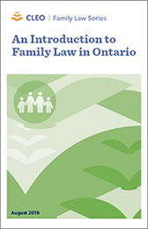
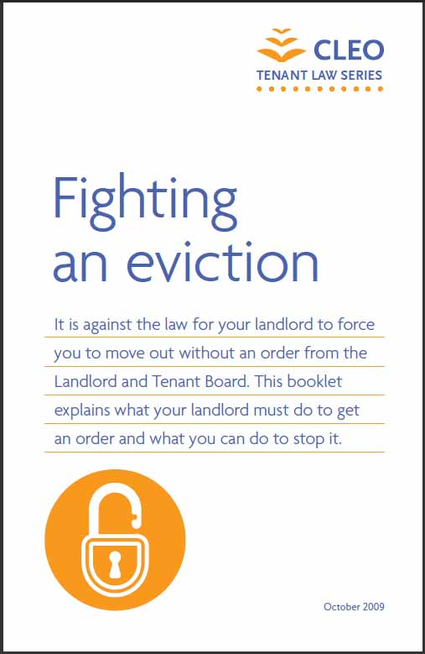
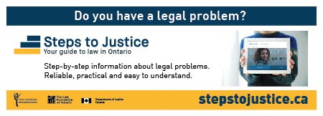
Creating more access to justice at your library:
1. Online:
Use Steps to Justice, CLEO, and Your Legal Rights to help patrons find legal information
Embed Steps to Justice on your library’s homepage
Bookmark the sites on public access computers
2. Public spaces:
Order and display CLEO’s free print resources
Make Steps to Justice bookmarks available to patrons
3. Make contact with your local community legal clinic:
Make sure to give out accurate info about their services
Invite them to present a public legal education session for your patrons on areas of need/interest (ie. tenants’ rights)
Ask for on-site lawyer to give patrons legal advice at library
All resources and bookmarks free
/

Slide 83
Contact:
Michelle Cader
Community Outreach Manager
michelle.cader@cleo.on.ca
416-408-4420 x 826
Thank you!!

